Slide 1
ARTIFICIAL INTELLIGENCE
SEMESTER : 8
SUBJECT CODE : 2180703

Slide 2
UNIT 4
Using Predicate Logic

Slide 3
Logic
The logical formalism of a language is useful because it immediately suggests a powerful way of deriving new knowledge from old using mathematical deduction.
In this formalism, we can conclude that a new statement is true by proving that it follows from the statements that are already known.
Proposition
A proposition is a statement, or a simple declarative sentence.
For example, “the book is expensive” is a proposition.
A proposition can be either true or false.

Slide 4
Propositional logic
Logical constants: true, false
Propositional symbols: P, Q, S,... (atomic sentences)
Propositions are combined by connectives:
Ù | and [conjunction]
Ú | or [disjunction]
Þ | implies [implication]
Ø | not [negation]
∀ | For all
∃ | There exists

Slide 5
Propositional logic is a simple language useful for showing key ideas and definitions.
User defines a set of propositional symbols, like P and Q.
User defines the semantics of each propositional symbol:
P means “It is hot”
Q means “It is humid” R means “It is raining”
A sentence (well-formed formula) is defined as follows:
A symbol is a sentence.
If S is a sentence, then Ø S is a sentence.
If S is a sentence, then (S) is a sentence.
If S and T are sentences, then (S Ú T), (S Ù T), (S ® T), and (S ↔ T) are sentences
A sentence results from a finite number of applications of the above rules.
Real world facts can be represented by well-formed formulas (wffs) in propositional logic.

Slide 6
Representation of Simple Facts in Logic
Propositional logic is useful because it is simple to deal with and a decision procedure for it exists.
In order to draw conclusions, facts are represented in a more convenient way as,
Marcus is a man. man(Marcus)
Plato is a man. man(Plato)
All men are mortal. mortal(men)
But propositional logic fails to capture the relationship between any individual being a man and that individual being a mortal.

Slide 7
How can these sentences be represented so that we can infer the third sentence from the first two?
Propositional logic commits only to the existence of facts that may or may not be the case in the world being represented.
It has a simple syntax and simple semantics. It suffices to illustrate the process of inference.
Propositional logic quickly becomes impractical, even for very small worlds.

Slide 8
Predicate logic
First-order Predicate logic (FOPL) models the world in terms of
Objects, which are things with individual identities
Properties of objects that distinguish them from other objects
Relations that hold among sets of objects
Functions, which are a subset of relations where there is only one “value” for any given “input”

Slide 9
First-order Predicate logic (FOPL) provides
Constants: a, b, dog33. Name a specific object.
Variables: X, Y. Refer to an object without naming it.
Functions: Mapping from objects to objects.
Terms: Refer to objects
Atomic Sentences: in(dad-of(X), food6) Can be true or false, Correspond to propositional symbols P, Q.
A well-formed formula (wff) is a sentence containing no “free” variables. That is, all variables are “bound” by universal or existential quantifiers.
("x)P(x, y) has x bound as a universally quantified variable, but y is free.

Slide 10
Quantifiers
Universal quantification
("x)P(x) means that P holds for all values of x in the domain associated with that
variable
E.g., ("x) dolphin(x) ® mammal(x)
Existential quantification
($ x)P(x) means that P holds for some value of x in the domain associated with that variable
E.g., ($ x) mammal(x) Ù lays-eggs(x)

Slide 11
Consider the following example that shows the use of predicate logic as a way of representing knowledge.
Marcus was a man.
Marcus was a Pompeian.
All Pompeians were Romans.
Caesar was a ruler.
All Pompeians were either loyal to Caesar or hated him.
Everyone is loyal to someone.
People only try to assassinate rulers they are not loyal to.
Marcus tried to assassinate Caesar.

Slide 12
The facts described by these sentences can be represented as a set of well-formed formulas (wffs) as follows:
Marcus was a man.
man(Marcus)
Marcus was a Pompeian. Pompeian(Marcus)
All Pompeians were Romans.
"x: Pompeian(x) ® Roman(x)
Caesar was a ruler.
ruler(Caesar)
All Pompeians were either loyal to Caesar or hated him.
inclusive-or
"x: Roman(x) ® loyalto(x, Caesar) Ú hate(x, Caesar)
exclusive-or
"x: Roman(x) ® (loyalto(x, Caesar) Ù Øhate(x, Caesar)) Ú
(Øloyalto(x, Caesar) Ù hate(x, Caesar))
Every-one is loyal to someone.
"x: $y: loyalto(x, y)
People only try to assassinate rulers they are not loyal to.
"x: "y: person(x) Ù ruler(y) Ù tryassassinate(x, y)
® Øloyalto(x, y)
Marcus tried to assassinate Caesar. tryassassinate(Marcus, Caesar)

Slide 13
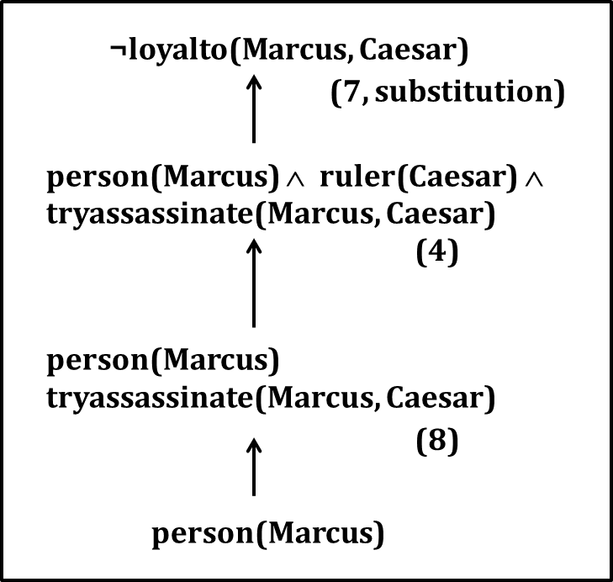
Now suppose if we want to use these statements to answer the question
Was Marcus loyal to Caesar?
Now let's try to produce a formal proof, reasoning backward from the desired goal:
¬ Ioyalto(Marcus, Caesar)
In order to prove the goal, we need to use the rules of inference to transform it into another goal (or possibly a set of goals) that can in turn be transformed, and so on, until there are no unsatisfied goals remaining.

Slide 14
Representing INSTANCE and ISA Relationships
Specific attributes instance and isa play important role particularly in a useful form of reasoning called property inheritance.
The predicates instance and isa explicitly captured the relationships they are used to express, namely class membership and class inclusion.
Fig. 4.2 shows the first five sentences of the last section represented in logic in three different ways.
The first part of the figure contains the representations we have already discussed. In these representations, class membership is represented with unary predicates (such as Roman), each of which corresponds to a class.
Asserting that P(x) is true is equivalent to asserting that x is an instance (or element) of P.
The second part of the figure contains representations that use the instance predicate explicitly.

Slide 15
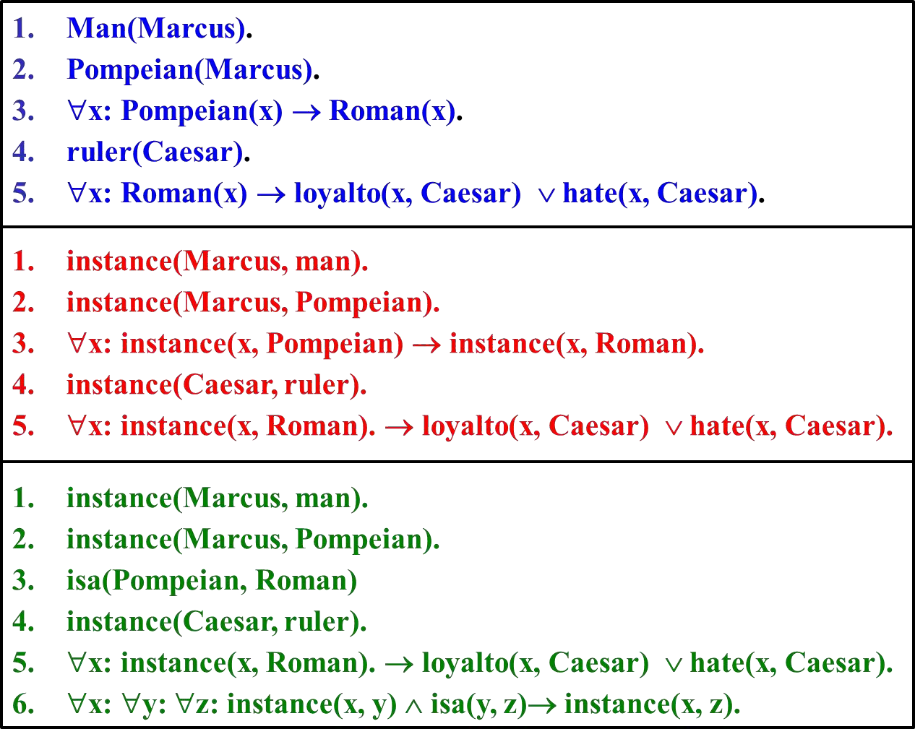

Slide 16
The predicate instance is a binary one, whose first argument is an object and whose second argument is a class to which the object belongs.
But these representations do not use an explicit isa predicate.
Instead, subclass relationships, such as that between Pompeians and Romans, are described as shown in sentence 3.
The implication rule states that if an object is an instance of the subclass Pompeian then it is an instance of the superclass Roman.
Note that this rule is equivalent to the standard set-theoretic definition of the subclass- superclass relationship.
The third part contains representations that use both the instance and isa predicates explicitly.
The use of the isa predicate simplifies the representation of sentence 3, but it requires that one additional axiom (shown here as number 6) be provided.

Slide 17
Computable Functions and Predicates
To express simple facts, such as the following greater-than and less-than relationships: gt(1,O) It(0,1)
gt(2,1) It(1,2)
gt(3,2) It( 2,3)
It is often also useful to have computable functions as well as computable predicates. Thus we might want to be able to evaluate the truth of
gt(2 + 3,1)
To do so requires that we first compute the value of the plus function given the arguments 2 and 3, and then send the arguments 5 and 1 to gt.
Consider the following set of facts, again involving Marcus:
Marcus was a man.
man(Marcus)
Marcus was a Pompeian. Pompeian(Marcus)
Marcus was born in 40 A.D. born(Marcus, 40)
All men are mortal.
∀x: man(x) → mortal(x)
All Pompeians died when the volcano erupted in 79 A.D. erupted(volcano, 79) ∧ ∀ x : [Pompeian(x) → died(x, 79)]
No mortal lives longer than 150 years.
∀x: ∀t1: At2: mortal(x) ∧ born(x, t1) ∧ gt(t2 - t1,150) → died(x, t2)
It is now 1991.
now = 1991
Above example shows how these ideas of computable functions and predicates can be useful.

Slide 18
It also makes use of the notion of equality and allows equal objects to be substituted for each other whenever it appears helpful to do so during a proof.
Now suppose we want to answer the question "Is Marcus alive?”
The statements suggested here, there may be two ways of deducing an answer.
Either we can show that Marcus is dead because he was killed by the volcano or we can show that he must be dead because he would otherwise be more than 150 years old, which we know is not possible.
As soon as we attempt to follow either of those paths rigorously, however, we discover, just as we did in the last example, that we need some additional knowledge. For example, our statements talk about dying, but they say nothing that relates to being alive, which is what the question is asking.

Slide 19
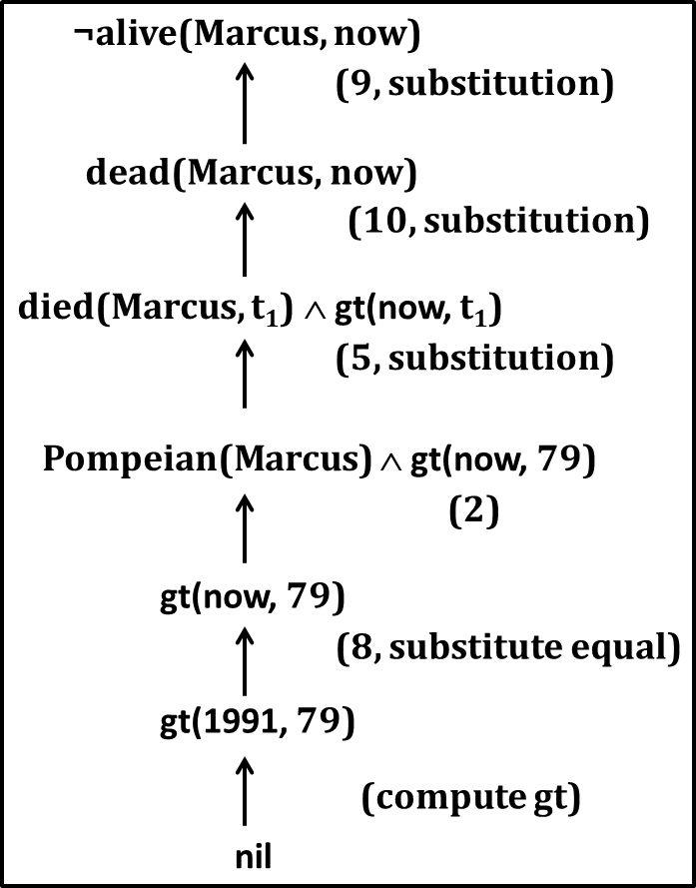
So we add the following facts:
Alive means not dead.
∀x: ∀t: [alive(x, t) → ¬ dead(x, t)] ∧ [¬ dead(x, t) → alive(x, t)]
If someone dies, then he is dead at all later times.
∀x: ∀t1: At2: died(x, t1) ∧ gt(t2, t1) → dead(x, t2)
Now let's attempt to answer the question "Is Marcus alive?" by proving:
¬ alive(Marcus, now)

Slide 20
Resolution
Resolution is a procedure, which gains its efficiency from the fact that it operates on statements that have been converted to a very convenient standard form.
Resolution produces proofs by refutation.
In other words, to prove a statement (i.e., to show that it is valid), resolution attempts to show that the negation of the statement produces a contradiction with the known statements (i.e., that it is unsatisfiable).
The resolution procedure is a simple iterative process: at each step, two clauses, called the parent clauses, are compared (resolved), resulting into a new clause that has been inferred from them. The new clause represents ways that the two parent clauses interact with each other. Suppose that there are two clauses in the system:
winter V summer
¬ winter V cold
Now we observe that precisely one of winter and ¬ winter will be true at any point.
If winter is true, then cold must be true to guarantee the truth of the second clause. If ¬ winter is true, then summer must be true to guarantee the truth of the first clause.
Thus we see that from these two clauses we can deduce
summer V cold

Slide 21
This is the deduction that the resolution procedure will make.
Resolution operates by taking two clauses that each contains the same literal, in this example, winter.
The literal must occur in positive form in one clause and in negative form in the other. The resolvent is obtained by combining all of the literals of the two parent clauses except the ones that cancel.
If the clause that is produced is the empty clause, then a contradiction has been found.
For example, the two clauses winter
¬ winter
will produce the empty clause.

Slide 22
Conversion to Clause form
To apply resolution, we need to reduce a set of wff's to a set of clauses, where a clause is defined to be a wff in conjunctive normal form but with no instances of the connector A.
We can do this by first converting each wff into conjunctive normal form and then breaking apart each such expression into clauses, one for each conjunct.
All the conjuncts will be considered to be conjoined together as the proof procedure operates. To convert a wff into clause form, perform the following sequence of steps.

Slide 23
Algorithm: Convert to Clause Form
Eliminate →, using the fact that a → b is equivalent to ¬ a V b. Performing this transformation on the wff given above becomes
∀x: ¬ [Roman(x) ∧ know(x, Marcus)] V
[hate(x, Caesar) V (∀y : ¬(∃z : hate(y, z)) V thinkcrazy(x, y))]
Reduce the scope of each ¬ to a single term, using the fact that ¬ (¬ p) = p, Performing this transformation on the wff from step 1 becomes
∀x: [¬ Roman(x) V ¬ know(x, Marcus)] V
[hate(x, Caesar) V (∀y: ∀z: ¬ hate(y, z) V thinkcrazy(x, y))]
Standardize variables so that each quantifier binds a unique variable. Since variables are just dummy names, this process cannot affect the truth value of the wff.
For example, the formula ∀x: P(x) V ∀x: Q(x) would be converted to ∀x: P(x) V ∀y: Q(y)

Slide 24
Move all quantifiers to the left of the formula without changing their relative order. This is possible since there is no conflict among variable names. Performing this operation on the formula of step 2, we get
∀x: ∀y: Az: [¬ Roman(x) V ¬ know(x, Marcus)] V [hate(x, Caesar) V (¬ hale(y, z) V thinkcrazy(x, y))]
Eliminate existential quantifiers. So, for example, the formula
∃y : President(y)
can be transformed into the formula
President(S1)
For example, in the formula
∀x: ∃y: father-of(y, x)
would be transformed into
∀x: father-of(S2(x), x)
These generated functions are called Skolem functions. Sometimes ones with no arguments are called Skolem constants.

Slide 25
Drop the prefix. At this point, all remaining variables are universally quantified, so the prefix can just be dropped and any proof procedure we use can simply assume that any variable it sees is universally quantified. Now the formula produced in step 4 appears as
[¬ Roman(x) V ¬ know(x, Marcus)] V
[hate(x, Caesar) V (¬ hate(y, z) V thinkcrazy(x, y))]
Convert the matrix into a conjunction of disjuncts. In the case or our example, since
there are no and’s, it is only necessary to exploit the associative property of or [ i.e., (a ∧
b) V c = (a V c) ∧ (b ∧ c)] and simply remove the parentheses, giving
¬ Roman(x) V ¬ know(x, Marcus) V
hate(x, Caesar) V ¬ hate(y, z) V thinkcrazy(x, y)
Create a separate clause corresponding to each conjunct. In order for a wff to be true, all the clauses that are generated from it must be true.
Standardize apart the variables in the set of clauses generated in step 8. By this we mean rename the variables so that no two clauses make reference to the same variable. In making this transformation, we rely on the fact that
(∀x: P(x) ∧ Q(x)) = ∀x: P(x) ∧ ∀x: Q(x)
Thus since each clause is a separate conjunct and since all the variables are universally
quantified, there need be no relationship between the variables of two clauses, even if they were generated from the same wff.

Slide 26
Algorithm: Propositional Resolution
Convert all the propositions of F to clause form.
Negate P and convert the result to clause form. Add it to the set of clauses obtained in step 1.
Repeat until either a contradiction is found or no progress can be made:
Select two clauses. Call these the parent clauses.
Resolve them together. The resulting clause, called the resolvent, will be the disjunction of all of the literals of both of the parent clauses with the following exception: If there are any pairs of literals L and ¬ L such that one of the parent clauses contains L and the other contains ¬L, then select one such pair and eliminate both L and ¬ L from the resolvent.
If the resolvent is the empty clause, then a contradiction has been found. If it is not, then add it to the set of clauses available to the procedure.

Slide 27
The Unification Algorithm
In propositional logic, it is easy to determine that two literals cannot both be true at the same time.
Simply look for L and ¬L in predicate logic, this matching process is more complicated since the arguments of the predicates must be considered.
For example, man(John) and ¬man(John) is a contradiction, while man(John) and
¬man(Spot) is not.
Thus, in order to determine contradictions, we need a matching procedure that compares two literals and discovers whether there exists a set of substitutions that makes them identical.
There is a straightforward recursive procedure, called the unification algorithm, that does it.

Slide 28
Algorithm: Unify(L1, L2)
If L1 or L2 are both variables or constants, then:
If L1 and L2 are identical, then return NIL.
Else if L1 is a variable, then if L1 occurs in L2 then return {FAIL}, else return (L2/L1).
Else if L2 is a variable, then if L2 occurs in L1 then return {FAIL}, else return (L1/L2).
Else return {FAIL}.
If the initial predicate symbols in L1 and L2 are not identical, then return {FAIL}.
If LI and L2 have a different number of arguments, then return {FAIL}.
Set SUBST to NIL. (At the end of this procedure, SUBST will contain all the substitutions used to unify L1 and L2.)
For i ← 1 to number of arguments in L1 :
Call Unify with the ith argument of L1 and the ith argument of L2, putting result in S.
If S contains FAIL then return {FAIL}.
If S is not equal to NIL then:
Apply S to the remainder of both L1 and L2.
SUBST: = APPEND(S, SUBST).
Return SUBST.

Slide 29
Resolution in Predicate Logic
We can now state the resolution algorithm for predicate logic as follows, assuming a set of given statements F and a statement to be proved P:
Algorithm: Resolution
Convert all the statements of F to clause form.
Negate P and convert the result to clause form. Add it to the set of clauses obtained in 1.
Repeat until a contradiction is found, no progress can be made, or a predetermined amount of effort has been expended.
Select two clauses. Call these the parent clauses.
Resolve them together. The resolvent will be the disjunction of all the literals of both parent clauses with appropriate substitutions performed and with the following exception: If there is one pair of literals T1 and ¬T2 such that one of the parent clauses contains T2 and the other contains T1 and if T1 and T2 are unifiable, then neither T1 nor T2 should appear in the resolvent. We call T1 and T2 Complementary literals. Use the substitution produced by the unification to create the resolvent. If there is more than one pair of complementary literals, only one pair should be omitted from the resolvent.
If the resolvent is an empty clause, then a contradiction has been found. If it is not, then add it to the set of clauses available to the procedure.

